Slide 1
Springfield Property manager
Week 3: 7/25/2020
7/20/2020 through 7/25/2020
75
13

Slide 2
Springfield property manager Code
Bariskoklu
AI: People move to the property they desire
People get very hungry at the start of the month
Vince McKeown
Opening Story
People’s dialog
Mdfewkes
Sound Engine

Slide 3
Springfield property manager Code
EyeForcz
Added Debug and Cheat code functions
Gonzalo Delgado
Fixed Case-Sensitive Bug
Michelly-Oliveira
peopleCharacteristics class
Pause Game
Vince McKeown
Game States

Slide 4

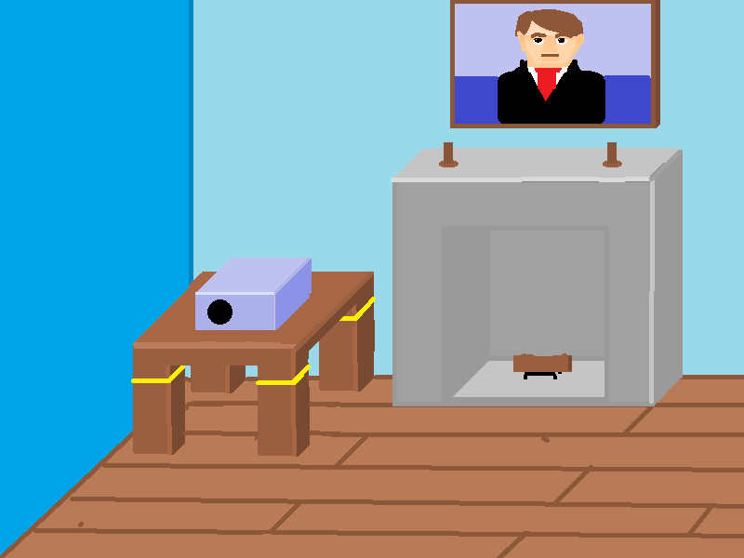
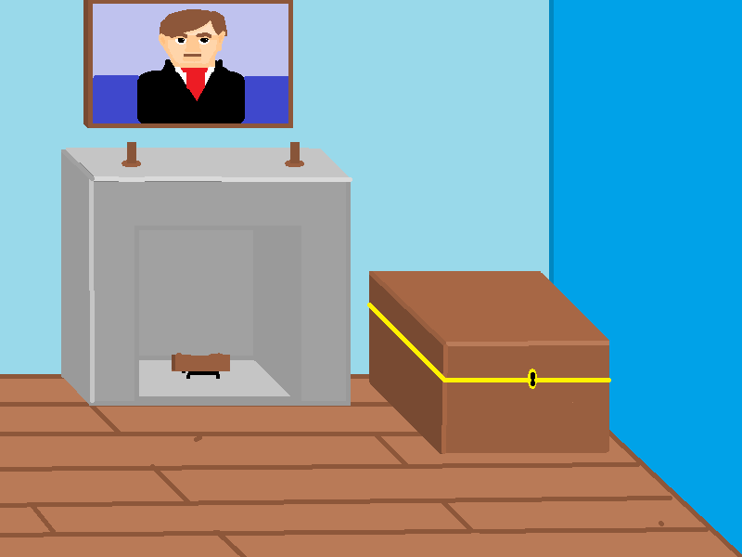
Springfield property manager Code
Casio101
Brazilian Steakhouse
Vince McKeown
Basic Office Building
Casio101
Unified Color Palette

